Slide 1

Gen AI – AI AGENT – AGENTIC AI

Slide 2
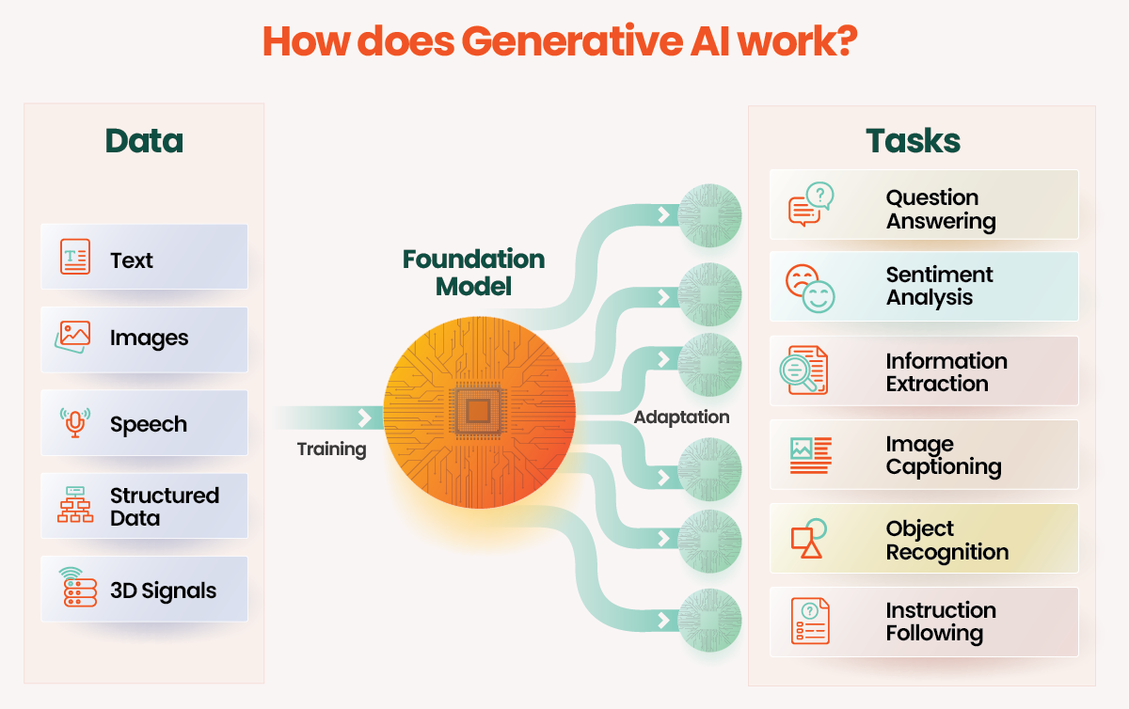
GenAI operates by training on vast amounts of data to learn patterns and relationships, subsequently creating new data that mirrors these learned patterns.

Slide 3
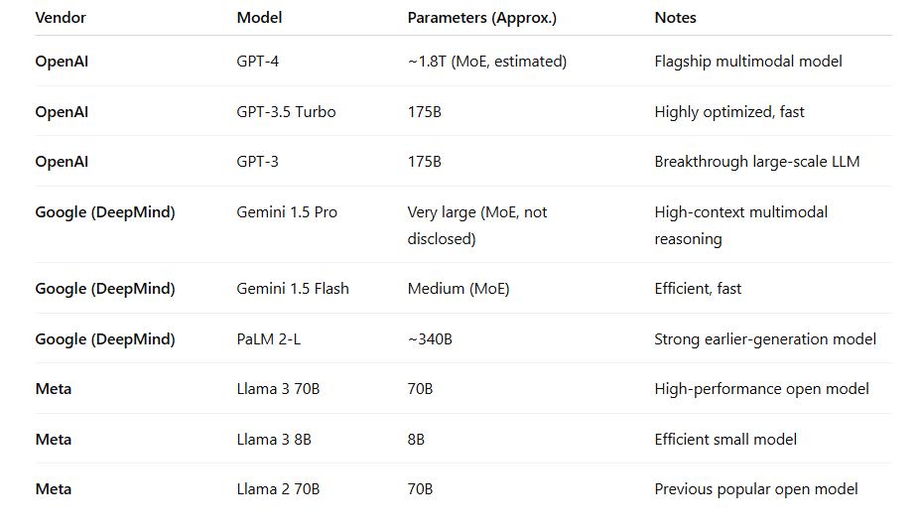
LLM

Slide 5
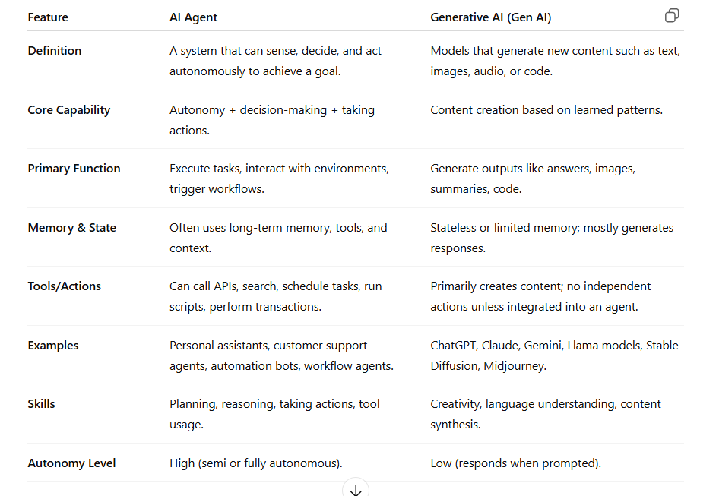
AI Agent vs Generative AI

Slide 6
Prompt in LLMs
A prompt is the input you give to a Large Language Model.
It tells the model what to do, what information you want, or how you want the output.
Examples of prompts for an LLM:
  “Explain machine learning in simple words.”
  “Write Python code to sort a list.”
  “Summarize this document.”
Purpose of a prompt in LLMs:
  Guide the model
  Set context
  Define output structure
  Control tone or format
LLM = responds to prompts → No memory or actions unless specified.

Slide 7
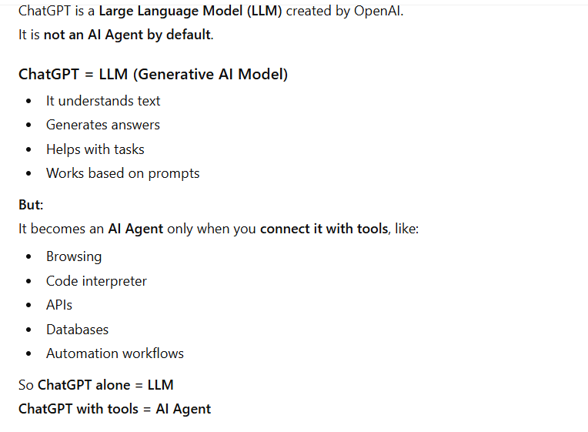

Slide 8
Super Easy Acronym – R.O.D
R – Role
  Tell the AI who to be.
  Example: “Act as a financial advisor.”
O – Objective
  Tell the AI what you want.
  Example: “Explain SIP vs Lumpsum investment.”
D – Deliverable
  Tell the AI how the answer should be presented.
  Example: “Give the explanation in a clear comparison table.”

Slide 9
Simple Acronym – S.M.A.R.T Prompt
S – Specific
  Ask a clear question.
  Example: Explain SIP vs Lumpsum.
M – Measurable
  Specify output format.
  Example: Use a comparison table.
A – Action
  Describe what you want the model to do.
  Example: Compare risk, returns, and ideal use case.
R – Role
  Assign expertise.
  Example: Act as a financial advisor.
T – Tone
  Define tone/style.
  Example: Use simple, beginner-friendly language.

Slide 10
Write a Perfect Prompt – P.R.O.M.P.T
P – Purpose
  Clearly state the goal.
  Example: I want to understand SIP vs Lumpsum.
R – Role
  Assign who the AI should act as.
  Example: Act as a financial advisor.
O – Output Format
  Specify exact structure.
  Example: Give the answer in a comparison table.
M – Must-Include Points
  List key details needed.
  Example: Cover risk, returns, and ideal duration.
P – Parameters
  Tone, depth, and length.
  Example: Simple language, short points.
T – Target Audience
  Tell who the explanation is for.
  Example: Explain for a beginner investor.

Slide 11
AI Agent Frameworks
1. LangChain
  A leading framework for building AI agent apps.
  It connects LLMs with tools, memory, APIs, and databases to perform actions.
2. LangGraph
  Built on LangChain for creating stateful, multi-step AI agents.
  Great for workflows, loops, planning, and complex reasoning tasks.
3. CrewAI
  A multi-agent framework where multiple AI agents work together like a team.
  Each agent has a role, tools, and responsibilities to complete bigger tasks.
4. Microsoft AutoGen
  Allows AI agents to communicate with each other and humans.
  Ideal for problem-solving, coding, and building collaborative agent systems.
5. n8n (AI + Automation Workflows)
  A no-code automation tool that can integrate AI agents into workflows visually.
  Used to automate emails, APIs, CRM, scheduling, and business processes with AI.

Slide 12
Most Important Components of an AI Agent
1. LLM Brain
  The model that understands, reasons, and generates responses.
2. Tools & Actions
  APIs, databases, search, code execution—allows the agent to act in the real world.
3. Memory
  Stores context, user details, and past interactions for smarter responses.
4. Planning & Reasoning
  Step-by-step thinking, decision-making, and task execution loops.
5. Workflow / Integrations
  Connections to apps (n8n, CRMs, emails, cloud) to automate end-to-end tasks.

